Slide 1
188 Section 8: Bayes Nets
Wednesday, October 8, 2017
Notes:
Lots of knowledge stolen from Sherdil Niyaz and Davis Foote!

Slide 2
Bayes Nets

Slide 3
Bayesian Networks
From last week’s section on probability review, we know that asking questions from a probabilistic model requires that we know the joint distribution
But that’s so big and messy!
Bayes Nets: Describes conditional independence relations. Now we only need to worry about conditional distributions b/w variables of the model ⇒ Implicitly gives us the joint distribution

Slide 4
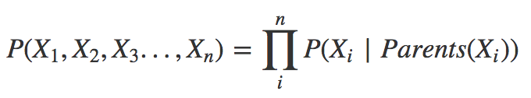
Rain “influences” traffic
Bayes net + parent equation gives us the full joint of the model:
We get these tables for each of the nodes!
RAIN
TRAFFIC

Slide 5
Conditional Independence in Bayes Nets

Slide 6
Conditional Independence
Regular Independence: If X and Y are independent random variables, P(X | Y) = P(X), and vice versa!
Conditional Independence: If X is conditionally independent of Y given Z, P(X | Z, Y) = P(X | Z). If we are given Z, X is not affected by event Y!

Slide 7
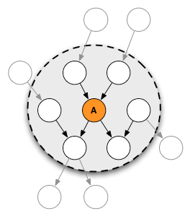
Markov Blanket(Node) = ...
A node in a Bayes Net is conditionally independent from the rest of the net given its parents, children, and all of its children’s parents.
Extension: A leaf node in a BN is conditionally independent from the others given all parents.

Slide 8
D-Separation: “Are A and B independent, given D and F?”
For hairy situations, you might have a hard time looking at the graph and deciding independence.
Here’s one way to help you reason it out!...
(this is not the same technique used in lecture, but same principles. You should definitely understand the method from lecture. If they don’t specify you to consider active/inactive triplets, I find the following method much easier.)

Slide 9
D-Separation via Moralization: “Are A and B independent, given D and F?”
Draw ancestral graph (include ancestor nodes of all nodes mentioned in expression + node itself)
Moralize the graph
For each pair of variables with a common child, draw an undirected edge (line) between them. (If a variable has more than two parents, draw lines between every pair of parents.)
"Disorient" the graph
replacing the directed edges (arrows) with undirected edges (lines).
Delete the givens and their edges.
For the statement above, it would be D, F
Read the graph
If the variables are disconnected in this graph, they are guaranteed to be independent.
If the variables are connected in this graph, they are not guaranteed to be independent.

Slide 10
You can prove independence via probability gymnastics too!
Using the information encoded in the Bayes Net and also all your probability rules and tricks

Slide 11


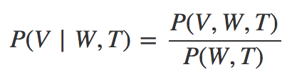
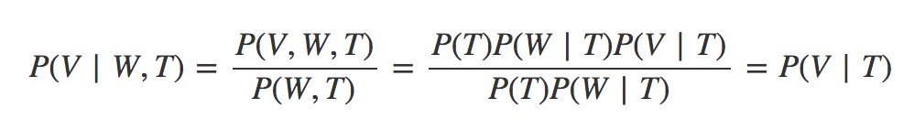
Is V independent of W given T?
YES
From the Bayes Net:
Conditional Probability Definition:
Combine and use definition of Conditional Independence:
T
V
W

Slide 12
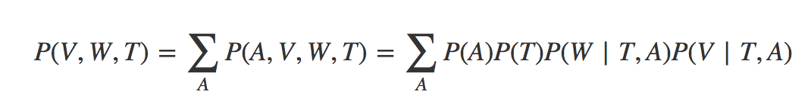
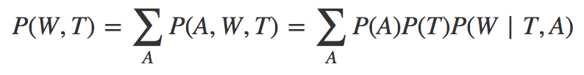
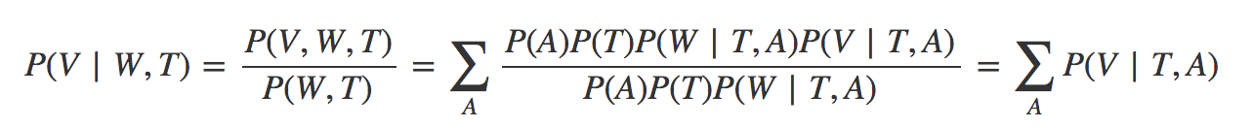
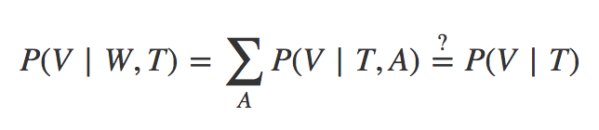
Is V independent of W given T?
Not necessarily
(see slides at the end if you don’t see this)
T
A
From the Bayes Net + Marginalization:
Conditional Probability Definition:
Combine:
(Try to) use definition of Conditional Independence:
V
W

Slide 13
Variable Elimination

Slide 14
We know
Bayes nets + the CPTs (conditional probability tables) + the Parent equation gives us the full joint distribution
If you have a full joint distribution, you can do magic with marginalization and normalization to get a specific CPT.
Inference by enumeration: We can compute out joint probability tables, then marginalize to get what we want, then apply formulas to get the answer to some query.

Slide 15
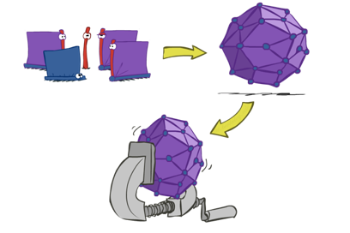
But….
Inference by Enumeration is inefficient- you build up the entire table then marginalize the probability that you care about. That’s not very efficient.

Slide 16
Remember: Normalization Trick
Say we have some CPT we are trying to find: P(Y | +z)
If we had the (marginal) JPT, P(Y, Z) we know we could use the normalization trick to get P(Y | +z).
P(Y, Z)
P(Y, +z)
P(Y |+z)
Y = | Z = | P
+y | +z | 0.2
-y | +z | 0.3
+y | -z | 0.1
-y | -z | 0.4
Y = | P
+y | 0.2
-y | 0.3
Y = | P
+y | 0.4
-y | 0.6
Fix evidence
normalize

Slide 17
Remember: Normalization Trick
So we know that
P(Y |+z) is proportional to P(Y, +z)
LET’S FOCUS ON P(Y, +z)!!!! (later normalize)
P(Y, +z)
P(Y |+z)
Y = | P
+y | 0.2
-y | 0.3
Y = | P
+y | 0.4
-y | 0.6
normalize

Slide 18
Find P(Y, +z)
Now we can use the Bayes net (+parent equation) and marginalization: (note that Z is fixed to be +z)
Oh god. That’s nasty. It’s the same problem as enumeration. Computing the JPT (and marginalizing after) will be inefficient.
But instead of computing a gigantic JPT, we’ll notice that we can push some of the summations inwards (marginalize early)!!

Slide 19
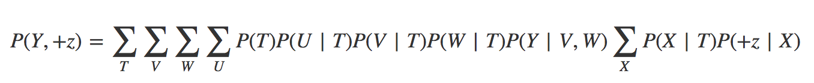
alternate notation:
f₁ (+z, T)
Eliminate X
f₁ (+z|T)
Let’s push the summation on X as far in as we can (I wrote it nicely, but sometimes, usually, you rearrange terms).
We can take this and just consider to be some factor that is determined by T and +z (X disappears as we sum over it). This factor is small and easier to compute. Furthermore, it gets rid of X so we don’t have to waste computation over X later.

Slide 20
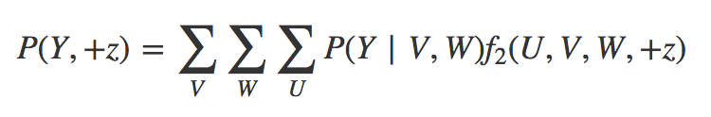
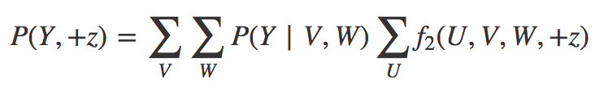
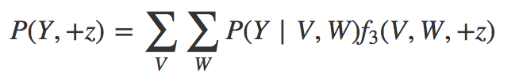

Eliminate the rest
You got rid of X
Now we’ll get rid of T:
(need to rearrange first)
And then U:
And then V and W: (because I’m lazy)

Slide 21

Oh Schnitz. You found P(Y, +z)!!! Normalize!
Perfection! Now remember how we said this is proportional to our goal?
… how did we get to our goal again?
NORMALIZATION!!!!!!

Slide 22
Put it all together: Variable Elimination
Fix your evidence (in the example, it would be Z = +z). Set up your goal as a marginalization of the joint.
Break up the joint using the Bayes Net (and the parent equation) to find your factors.
^{[1]}Eliminate each variable V that is not in your goal (in the example, it’s everything but Y and +z):
Collect the factors that depend on V
Sum out V to create a factor that only depends on what remains in the factors you collected
The final factor is what you need to normalize!
Notes:
[1] Note that the order you decide to do this in will greatly affect your efficiency

Slide 23
Summary: Inference on Bayes Net

Slide 24
Inference given Joint Distribution
You’ll be asked to calculate P(Query|evidence). How?
Enumeration (never really covered in discussion, but it’s not hard)
Variable Elimination (just earlier)
Sampling (approximate)... next time

Slide 25
Inference By Enumeration
Goal: Find P(Query | Evidence) Given: Evidence: E₁ = e₁, E₂ = e₂, … E_{k} = e_{k} Query variable(s): Q Hidden variables: H₁,H₂,...H_{R} (all the extraneous random vars in the Bayes Net)
Compute full JPT via Bayes Net and parent equation
Select entries consistent with evidence to get P(Query, Evidence, Hidden)
Sum out (a.k.a. marginalize) all of H_{i} for P(Query, Evidence)
Normalize to get P(Query | Evidence)

Slide 26
Inference By Variable Elimination
Goal: Find P(Query | Evidence) Given: Evidence: E₁ = e₁, E₂ = e₂, … E_{k} = e_{k} Query variable(s): Q Hidden variables: H₁,H₂,...H_{R} (all the extraneous random vars in the Bayes Net)
Let factors = tables
Initially, each CPT is a factor. For each factor, select entries consistent with evidence.
Eliminate hidden variables:
While hidden_variables not empty: New factor = Pick H, Join all factors with H, Sum out H
Normalize to get P(Query | Evidence)
Why eliminate?
You don’t want to compute the full JPT like done in step one of enumeration. We eliminate as much as we can early so we never loop over a huge table.

Slide 27
[continued from slide 11]
∑_{A}P( V | T, A) = P( V | T) ???

Slide 28
Let’s work with something concrete….
P( V | T , A ) =
Each table sums up to 1
Sanity Check
Make sure you know why there are four tables…
T and A have 2 outcomes each. [See speaker notes at bottom]
P(V|+t, +a)
P(V|-t, +a)
P(V|+t, -a)
P(V|-t, -a)
V = | P
+v | 0.5
-v | 0.5
V = | P
+v | 0.2
-v | 0.8
V = | P
+v | 0.1
-v | 0.9
V = | P
+v | 0.7
-v | 0.3
Notes:
Remember our interpretation of conditional probability as just “zooming in” our world to where the conditions are true-- if that is the world, the probabilities sum up to one. If there are two random variables conditioned on, each with 2 outcomes, you have 4 possible conditions to zoom in on. So four tables.
Note from Caryn: I remember this very easily when I remember the pictoral interpretation (euler’s diagram). If you never learned it that way, here’s a resource: https://brilliant.org/wiki/conditional-probability-distribution/

Slide 29
Smash some tables together...
P( V | T , A ) =
Each table sums up to 2
P(V|T, +a)
P(V|T, -a)
V = | T= | P
+v | +t | 0.5
-v | +t | 0.5
+v | -t | 0.2
-v | -t | 0.8
V = | T= | P
+v | +t | 0.1
-v | +t | 0.9
+v | -t | 0.7
-v | -t | 0.3

Slide 30
One last smash
P( V | T , A ) =
Table sums up to 4
V = | T= | A= | P
+v | +t | +a | 0.5
-v | +t | +a | 0.5
+v | -t | +a | 0.2
-v | -t | +a | 0.8
+v | +t | -a | 0.1
-v | +t | -a | 0.9
+v | -t | -a | 0.7
-v | -t | -a | 0.3

Slide 31
Sum over A
∑_{A}P( V | T , A ) =
Table STILL
sums up to 4
V = | T= | A= | P
+v | +t | +a | 0.5
-v | +t | +a | 0.5
+v | -t | +a | 0.2
-v | -t | +a | 0.8
+v | +t | -a | 0.1
-v | +t | -a | 0.9
+v | -t | -a | 0.7
-v | -t | -a | 0.3

Slide 32
Compare ∑_{A}P( V | T, A) and P( V | T )
As a metric (if T can be either +t or -t) we know that P( V | T ) sums up to 2
In the previous run through, ∑_{A}P( V | T, A) sums up to 4.
Obviously, the two don’t give us the same table...
What happens if A is ALWAYS +a (never anything else)? What would that mean in terms of conditional independence?

